Slide 1


Finite Automata Formal Languages
18CS52
(2022 – 2023)
Name | Shreyasa Joshi
USN | 1RV20CS198
Faculty | Dr. Chethana R Murthy
QUESTION
For a string x ∈ {a, b}∗ with |x| = n, how many states are required for an FA accepting the
language of all strings in {a, b}∗ that begin with x? For each of these states, describe the
strings that cause the FA to be in that state.

Slide 2
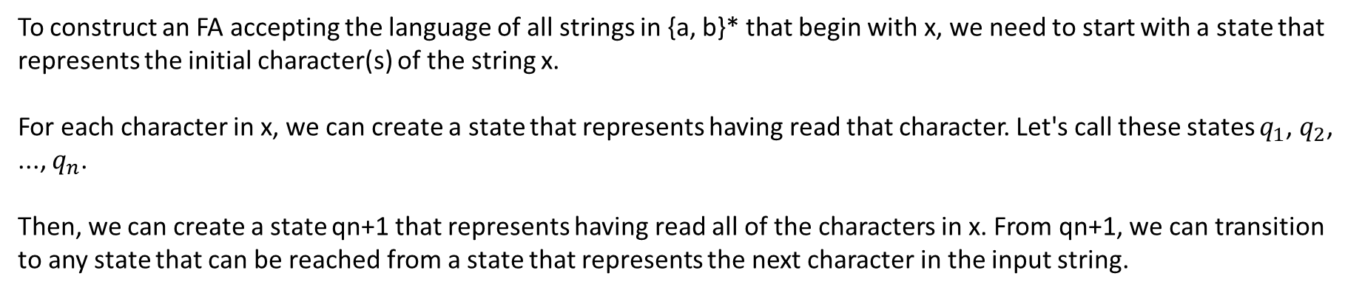
SOLUTION
To construct an FA accepting the language of all strings in {a, b}* that begin with x, we need to start with a state that represents the initial character(s) of the string x.
For each character in x, we can create a state that represents having read that character. Let's call these states $q_{1}$, $q_{2}$, ..., $q_{n}$.
Then, we can create a state qn+1 that represents having read all of the characters in x. From qn+1, we can transition to any state that can be reached from a state that represents the next character in the input string.

Slide 3
SOLUTION
Logic to construct NPDA :
Since each a must have 3 b’s associated with it, we push 3 a’s into the stack whenever an a is encountered but pop only a single a when b is encountered.

Slide 4
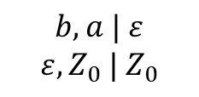

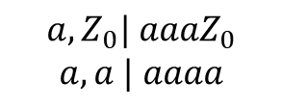
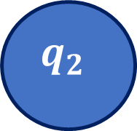

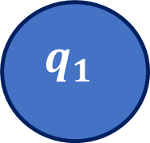

SOLUTION
NPDA :
$$a,Z_{0}| a{aaZ}_{0}$$
$$a, a | aaaa$$
$$b, a | ε$$
$$q_{0}$$
$$q_{1}$$
$$q_{2}$$
$$b, a | ε$$
$$ε, Z_{0} | Z_{0}$$
$$ε, Z_{0} | Z_{0}$$

Slide 5

SOLUTION
7 tuple definition - P = ($Q$, Σ, $Q_{0}$, F, δ, Γ, Z) :
P = ( {$q_{0},q_{1}$, $q_{2}$}, {a, b}, {$q_{0}$}, {$q_{2}$}, δ, {a, b, $Z_{0}$},{$Z_{0}$})

